Slide 1
Secure Web Programming
Lecture 9 ajax and web applications
Amanda.Lunt@utas.edu.au
Soonja.Yeom@utas.edu.au

Slide 2
Topics
Secure Web Programming
Week13
Review
Basic Web Programming
Web Security
Adv. Web Programming
Fundamentals – protocol, CS model, etc.
HTTP Protocols, Storage
Advanced Web Applications
Human Computer Interaction with Web Page Design
Security Issues and Technologies
Session management
Client-side Scripting Language and Document Object Model
Secure Programming and Users
Common Gateway Interface
Server-side Scripting Language and Privilege configuration
Encryption and Authentication
Advanced Security Issues

Slide 3
Review: Various types of attacks
We will learn several modes of attacks and how to prevent those attacks:
Phishing attacks
Fool the users
Network attacks
Attack the connection
Code injection attacks
Attack the server or browser (e.g. sql injection, StoredXSS, ReflectedXSS)
Other attacks….

Slide 4
Review: Encryption Techniques
There are two common encryption techniques
Symmetric Key Encryption
Public Key (Asymmetric Key) Encryption
ajsdhj
asdklajs
original
message
key
encrypted
message
key
original
message
ajsdhj
asdklajs
original
message
public
key
encrypted
message
private
key
original
message

Slide 5
Review: SSL (Secure Socket Layer)
Protocol used for secure communication between browsers and servers
Browser uses certificate to verify server’s identity
Uses certificates and public-key encryption to pass a secret session-specific key from browser to server
HTTP
IMAP
LDAP
SSL
SSL sits above the TCP/IP layer, but below the applications layer in the communications stack
TCP/IP

Slide 6
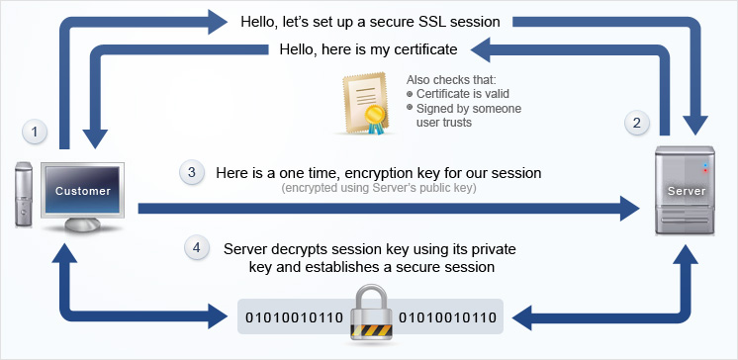
Review: SSL Process
http://www.awardspace.com/ssl-certificates/what-is-ssl-certificate

Slide 7
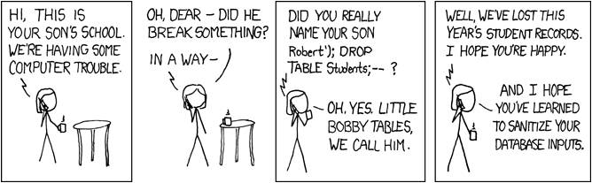
Review: Code Attacks example
What type of code attack does this following image show?
Then, how can we prevent this attack?

Slide 8
Review: Prevent SQL injection attacks
Then, how to prevent those SQL injection attacks.
The most common solution is using mysqli->real_escape_string()
real_escape_string function escapes special characters in a string for use in an SQL statement
$username = $mysqli->real_escape_string($_POST[ ‘username’ ]); $password = $mysqli->real_escape_string($_POST[ ‘password’ ]); $query = “SELECT * FROM usertable WHERE username=‘$username’ AND password=’$password’”;

Slide 9
Classic Web Application Model
In traditional web sites
browser requests an entire page from the server (HTTP request object)
server sends the page (HTTP response object)
a user action (eg click link, submit form) causes a new request
server sends another page
communication is synchronous (browser must wait for the page to load before rendering it or executing the scripts)

Slide 10

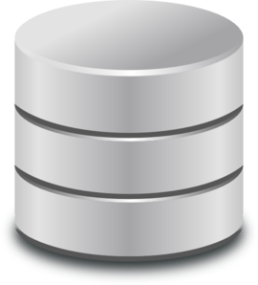

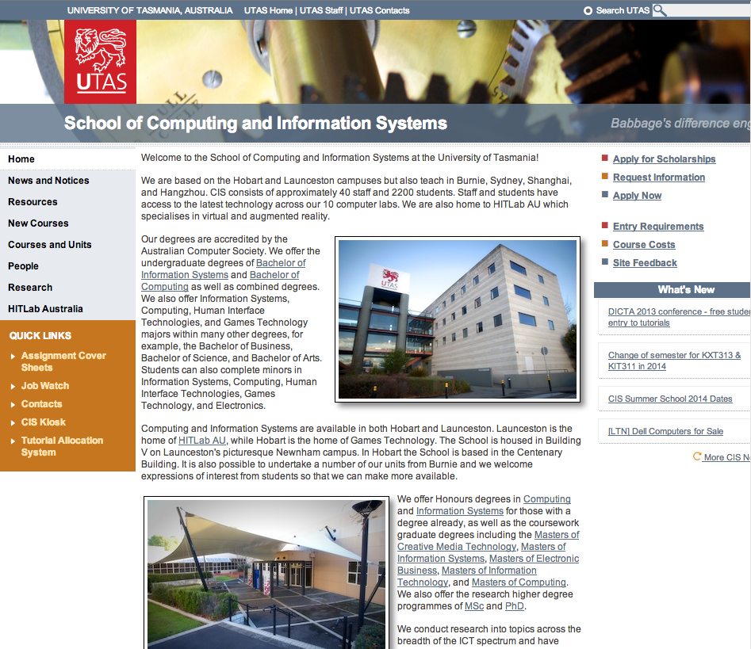
Classic Web Application Model
Server holds (or produces) web pages
Sends whole pages to the client
Request message: produced in response to user action
Response message: from server to client (output)
Request for the content of the webpage
Query
Database
Response message – File output
Data
Client computer
Server
Classic Web Application Model

Slide 11
Synchronous communication
Classical model is “Synchronous” communication
What does "synchronous" mean? events occurring at the same time
Steps - as described above "synchronous" because
the timing of the events must happen in the order given - actually
after the request is sent - client waits for a response from the server
nothing is rendered until all of the page is received

Slide 12
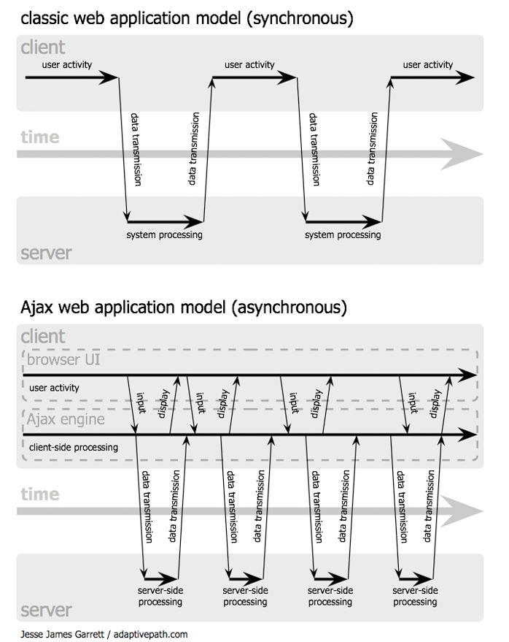
Synchronous communication

Slide 13
Asynchronous communication
browser could send a request
browser goes on with whatever it is doing
browser "checks" every so often to see if the response has come
when the response (finally) arrives
the browser extracts the information from the response and does whatever it needs to with it

Slide 14
Asynchronous communication

Slide 15
What is AJAX?
Asynchronous Javascript and XML
A technique to download data from a server without reloading your page
Allows dynamically updating sections without requesting by users
Update by replacing DOM contents of fetched contents from the server by using XML.
text or json file can be used as well. json is commonly used these days.
Try to overcome problems of Web pages:
No more ‘click and wait’ if it is not necessary
Change only relevant sections
Make more interactive page

Slide 16
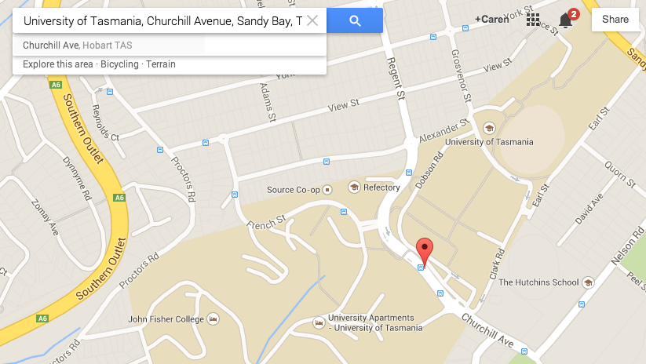
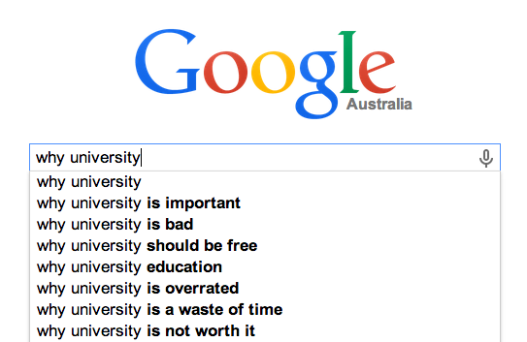
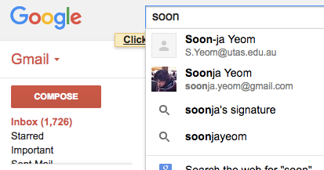
Web Applications with AJAX
Google search - query suggestion
Google Map
Gmail

Slide 17
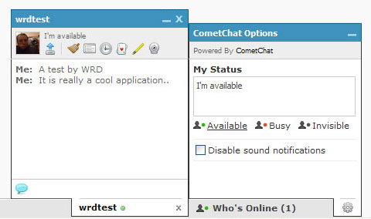
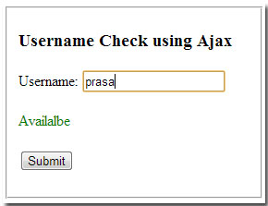
Web Application with AJAX
Chat Room (e.g. facebook, old-version gtalk)
FORM with Ajax (e.g. username checker)

Slide 18
Classic Model vs AJAX Model
Classic Web Application Model
AJAX Web Application Model
Request message
Query
Database
Response message (HTML+CSS+JavaScript…)
Data
Client computer
Server
User Interface
JavaScript call
AJAX Engine
Request message
Query
Database
Response (HTML + CSS Data…)
Response message (Data – plain text, XML, or Json Data)
Data
Server
Client computer

Slide 19
AJAX process steps
"in the background" client side program
initiates HTTP request (usually this is JavaScript - but can be done with other client side languages)
sends it to the server - can usually only be the server which originally provided the JavaScript
client side program is "notified" when the HTTP response is received (Asynchronous)
"in the background" client side program checks the response message and extracts the contents (often but not necessarily XML)
relevant parts of the page are updated

Slide 20
Technologies in AJAX
Standards-based presentation using HTML and CSS
web page code that is standards compliant (so that it can be manipulated programmatically)
Data interchange using XML (the "payload" in the response messages).
Technologies exist to query (XQuery) and manipulate (XSLT) XML
JavaScript "binding everything together" - this means that it is possible to have:
asynchronous data retrieval using XMLHttpRequest (an object that represents an HTTP message)
dynamic display and interaction using the Document Object Model

Slide 21
AJAX “toolkit”
A combination of technologies are needed:
a server-side language (eg PHP) used to produce the responses
valid markup (eg XHTML, HTML)
DOM scripting (to modify parts of a page when needed)
HttpRequest object - to send the messages to the server
A means of data transfer (datatype can be plain text or XML or JSON…)

Slide 22
DOM (Review from lecture 2)
Document Object Model
a standard way for accessing and manipulating HTML documents
Document/Frame object
Tree structure
<html>
<head>
<title> Sample </title>
</head>
<body>
<table> sample1 </table>
<form> sample2 </form>
<p> sample3 </p>
</body>
</html>
html
head
body
title
table
form
p

Slide 23
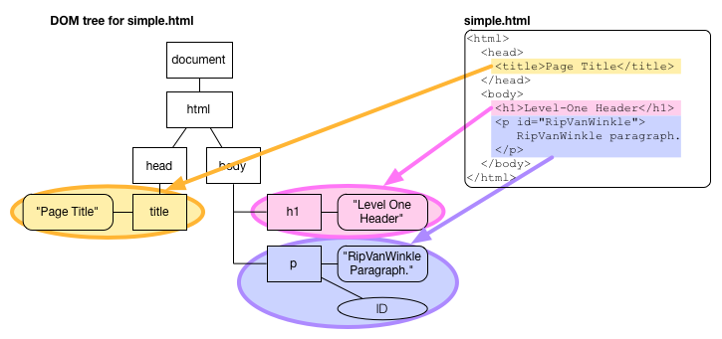
DOM: Type of Nodes

Slide 24
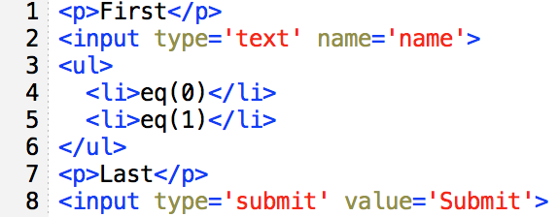
DOM and jQuery
jQuery syntax is designed for making easier to access DOM (Selector $)
$("p")
$("ul li:eq(1)")
$(”:input")
$("p:last")

Slide 25
AJAX “toolkit”
A combination of technologies are needed:
a server-side language (eg PHP) used to produce the responses
valid markup (eg XHTML, HTML)
DOM scripting (to modify parts of a page when needed)
HttpRequest object - to send the messages to the server
A means of data transfer (datatype can be plain text or XML or JSON…)

Slide 26
HTTPRequest object
The HTTPRequest object
can be created by client side programming languages (eg,. JavaScript)
allows the (client side) script to connect to the server (using HTTP)
properties / methods of the object allow the programmer to do things like:
set the contents of the query string (or the post data)
specify the method (GET, POST)
specify what will be done with the response (using a callback function)
send the HTTP request

Slide 27
HTTPRequest object
Browsers are not (yet) uniform in the way that HTTPRequest objects are created
code usually needs to provide different options for different browsers
The callback function must:
check the state of the response (equivalent to looking at the initial line)
deal with the contents - this usually means:
extracting (parsing) the contents
putting it into the correct place in the DOM (the html of the page)

Slide 28
HTTPRequest using jQuery
$.ajax() function performs an HTTPrequest (in AJAX model).
Specifying data type parameter.
url: string containing the URL to which the request is sent
datatype: type of data that you're expecting back from the server (e.g. plain, xml, json …)
type: type of HTTP request method (e.g. get –default type, post)
data: data to be sent to the server
done: A function to be called if the request is done

Slide 29
HTTPRequest using jQuery: Example
GET method
$.ajax({
url: url,
data: data,
done: done,
dataType: datatype
});
Example
$.ajax({
type: 'post',
url: "some.php",
data: { name: "John", location: "Boston" }
})
.done(function( msg ) {
alert( "Data Saved: " + msg );
});
POST method
$.ajax({
type: 'post',
url: url,
data: data,
done: done,
dataType: datatype
});

Slide 30
AJAX “toolkit”
A combination of technologies are needed:
a server-side language (eg PHP) used to produce the responses
valid markup (eg XHTML, HTML)
DOM scripting (to modify parts of a page when needed)
HttpRequest object - to send the messages to the server
A means of data transfer (datatype can be plain text or XML or JSON…)

Slide 31
A means of data transfer – Data type
Data exchange is very important in many applications (AJAX is just one example)
Various data type are used in AJAX data transfer
plain text (that the receiver must parse)
JSON - relatively recent (from 2000s)
XML - that the receiver can use Javascript methods to process

Slide 32
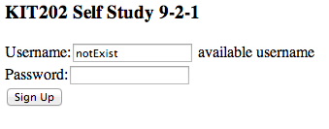
Data Transfer – type 1: plain text
A plain text string
The plain text type return the data with no processing
Example using jquery
$.ajax({
url: ”checker.php",
datatype: 'text',
data: {username: username}
})
.done(function(data) {
$("#output").html(data);
});
$.get(
url: ”checker.php”,
data: {username: username})
.done(function(data) {
$("#output").html(data);
});
same
[example output in the self-study 9_2_1.html]
NOTE: checker.php contains the SQL query that checks the whether username exists or not

Slide 33
Data Transfer – type2: JSON
Javascript Object Notation
Data exchange is very important in many applications (AJAX is just one example)
various methods are used (as mentioned in slides above)
plain text (that the receiver must parse)
XML - that the receiver can use Javascript methods to process
JSON - relatively recent (approx 2000s)
programming language model for data interchange
minimal, textual, subset of Javascript
based on Javascript object literals - JSON object declaration looks like a javascript object literal declaration.

Slide 34

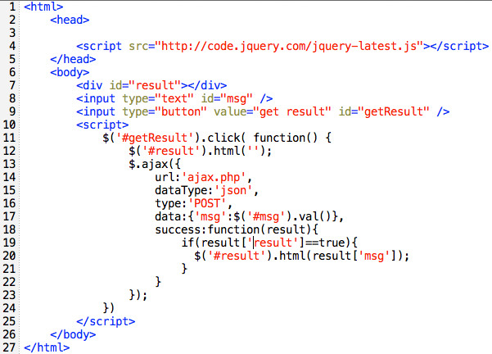

Data Transfer – type2: JSON: example
[[ajax.html]]
[[output]]
AJAX process in this page
User types “KIT202 hello!” and clicks “get result” button in the browser.
Send POST data ‘msg’ (the value of input box id ‘msg’)
Receives POST data ‘msg’
Returns the JSON representation of a value: array('result'=>true, 'msg'=>$_POST['msg'])
Send json data that contains the array {`result`: 1,`msg’: ‘KIT202 hello!’ }
Check whether results[‘result’] is true and display the results[‘result’]
[[ajax.php]]

Slide 35
Data Transfer – type3: XML
Extensible Markup Language
a standard (set of rules) for defining markup languages
can marked up with tags (elements) and attributes that are relevant for any knowledge domain
simple text
useful for data transfer
tools / technologies exist to manipulate XML in various ways
various programs - can parse XML to extract the data
XSLT - provides a way of transforming from one markup language to another
XPath, XQuery - provide ways to "query" a body of marked up text
other XML "dialects" designed to mark up data for specific purposes

Slide 36
Data Transfer examples– JSON & XML
GET method with JSON
$.ajax({
url: “example.json”,
data: data,
done: done,
dataType: “json”
});
$.getJSON({
url: “example.json”,
data: data,
done: done,});
same
GET method with XML
$.ajax({ url: “example.xml”,
data: data,
dataType: “xml”
}).done(function(xml){
var item =$(xml).find(“item”);
$(item).each(function(){
$(“#output”).append($(“enclosure”).attr(“url”).text()+”<br/>”);
});
});

Slide 37
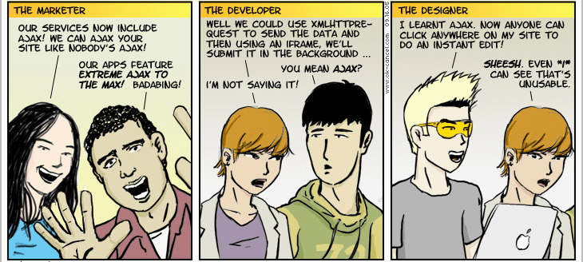
In Summary
AJAX approach
idea of asynchronous communications
uses technologies we have already seen (and mastered?)
XHTML, DOM scripting with Javascript, event handling

Slide 38
More AJAX examples
File upload system
http://www.ajaxf1.com/demo/ajaxupload/
Auto completer
http://res.nodstrum.com/autoComplete/index.htm
Auto-populating select box
http://remysharp.com/wp-content/uploads/2007/09/select-chain.php
Ajax button
http://www.ajaxonomy.com/files/backbuton.htm

Slide 39
Thank you
Any Questions

